Slide 1
Introduction to Deep Learning
Katharina Kann
Tech Frontiers – Machine Learning

Slide 2
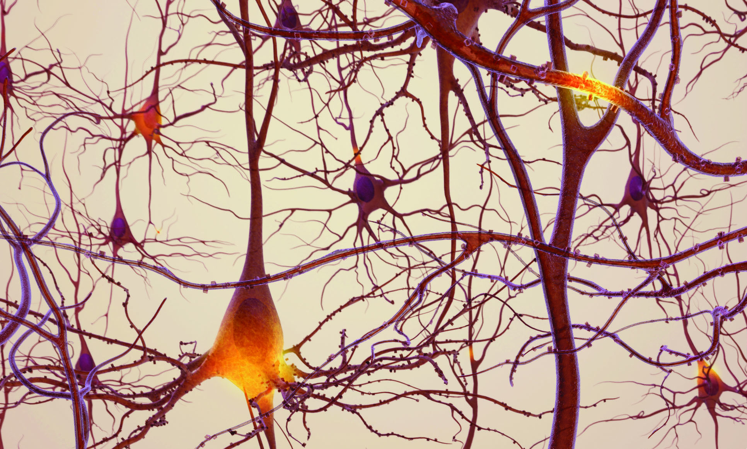
Motivation
The neural networks we will talk about don’t look much like this!
Image from https://cmns.umd.edu/news-events/features/2501

Slide 3


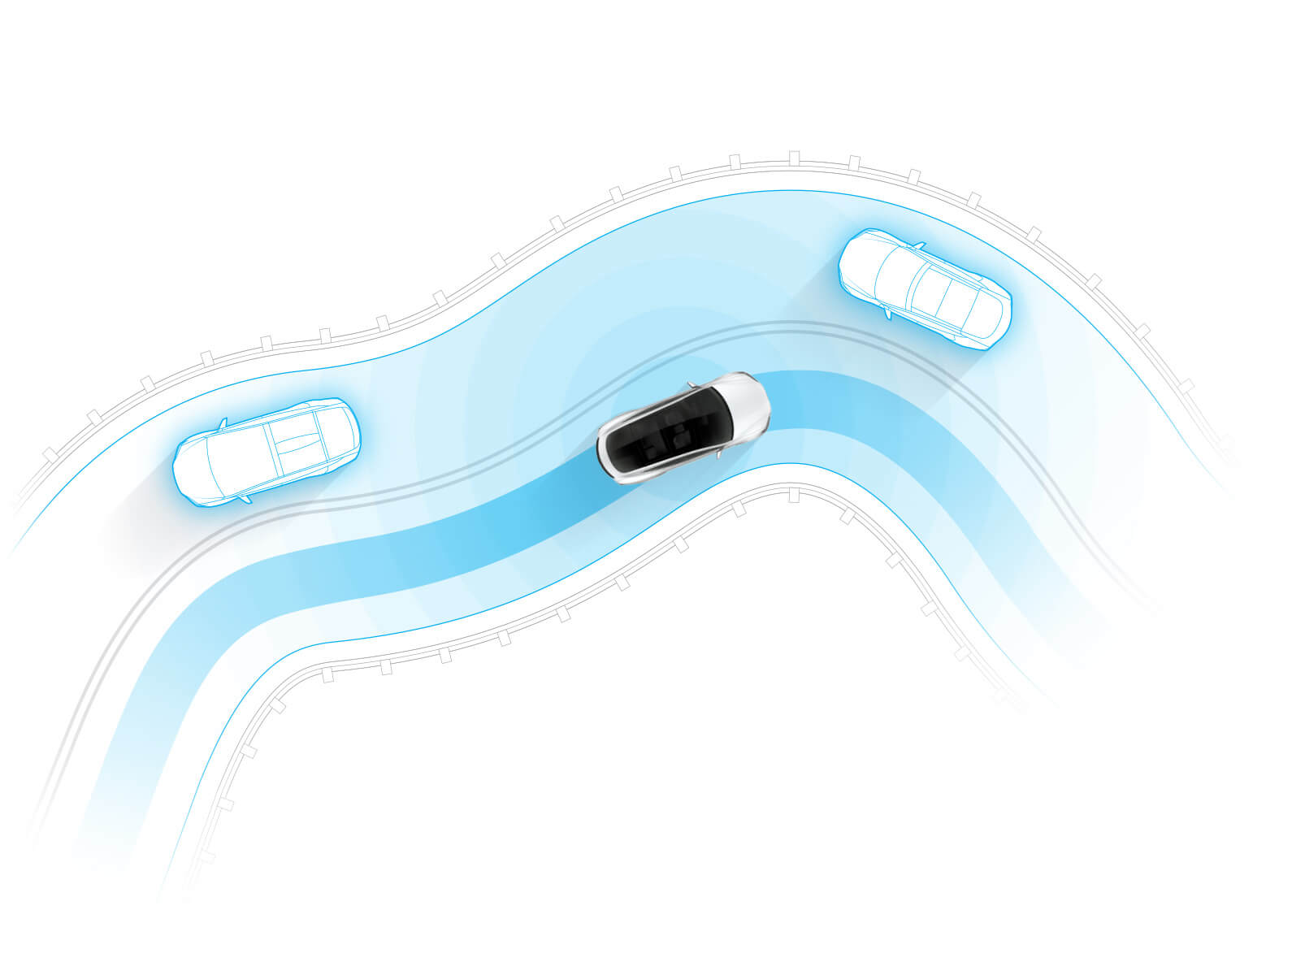

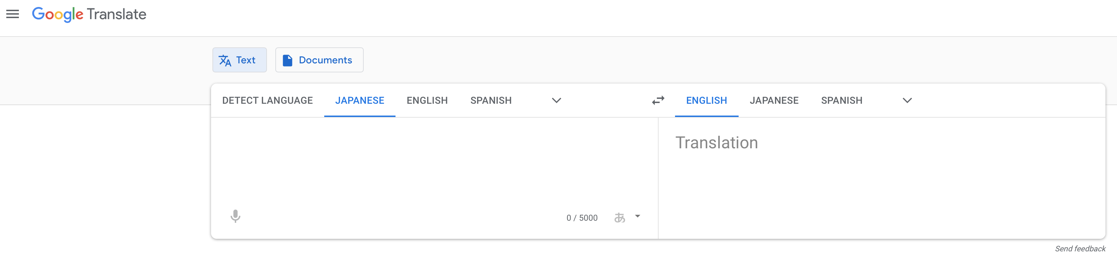
Application Examples
Image from https://www.pocket-lint.com/phones/news/apple/142207-what-is-apple-face-id-and-how-does-it-work
Image from https://www.tesla.com/autopilot

Slide 4
About Features
No feature engineering needed
Neural networks detect on their own what parts of the raw input are important
They are really good at this

Slide 5
Overview
Sequence classification
Sentiment analysis
Natural language inference
Sequence labeling
Part-of-speech tagging
Named entity recognition
Sequence generation
Language modeling
Machine translation

Slide 6
Perceptron

Slide 7
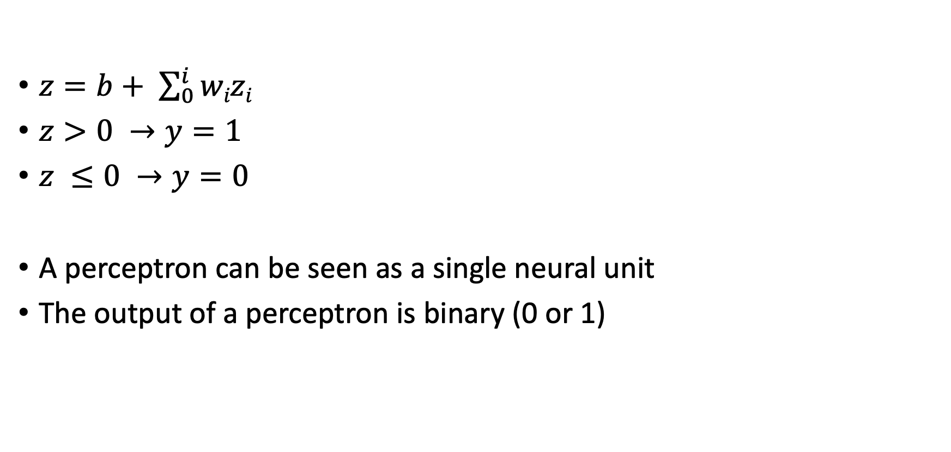
Perceptron
$z=b+ \sum_{0}^{i}{wizi}$
$z>0 →y=1$
$z ≤0 →y=0$
A perceptron can be seen as a single neural unit
The output of a perceptron is binary (0 or 1)

Slide 8
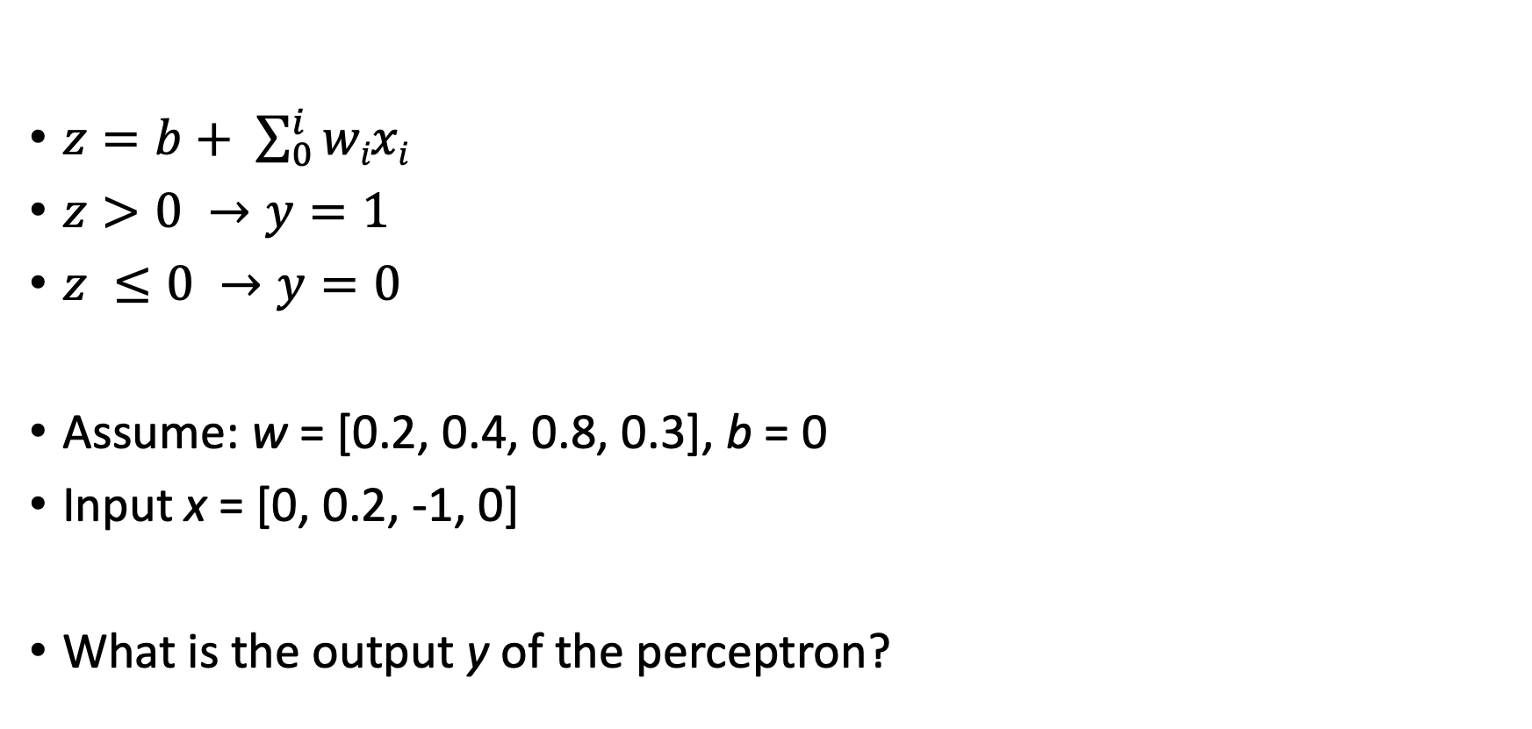
Perceptron: Example
$z=b+ \sum_{0}^{i}{wixi}$
$z>0 →y=1$
$z ≤0 →y=0$
Assume: w = [0.2, 0.4, 0.8, 0.3], b = 0
Input x = [0, 0.2, -1, 0]
What is the output y of the perceptron?

Slide 9
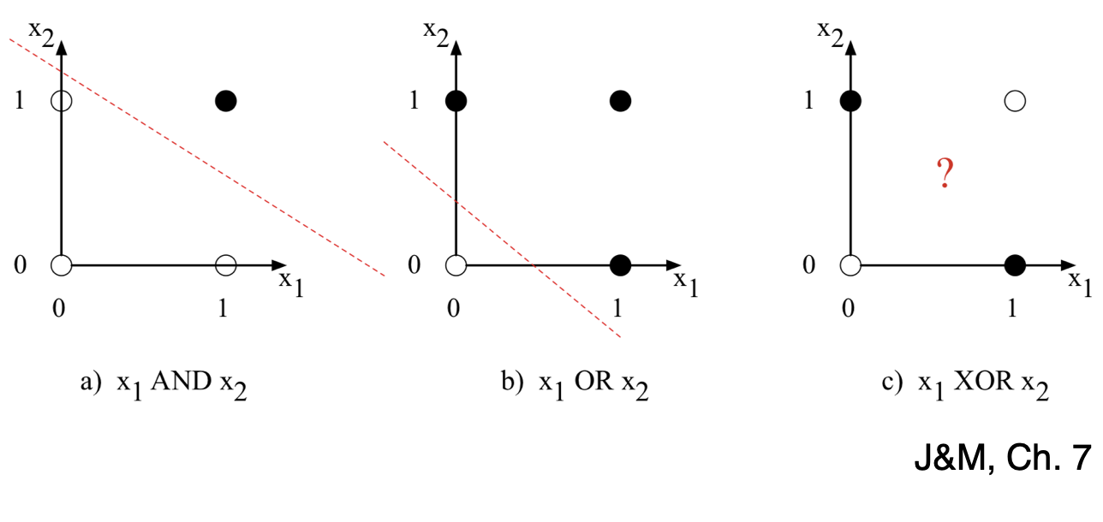
XOR Function
The perceptron cannot compute XOR
The perceptron is a linear classifier.
Decision boundary is a line, but XOR is not linearly separable
Solution: Deep neural networks!

Slide 10
XOR Function
x₁/x₂ | 0 | 1
0 | 0 | 1
1 | 1 | 0
The perceptron is a linear classifier
Decision boundary is a line, but XOR is not linearly separable
Solution: Deep neural networks!

Slide 11
Nonlinear Functions

Slide 12
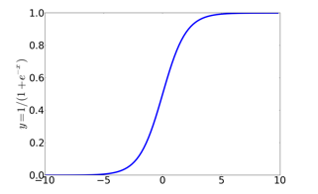
Sigmoid
Maps output to a range between 0 and 1
Useful for outliers!
Can represent probabilities
Is differentiable
Handy for learning!

Slide 13
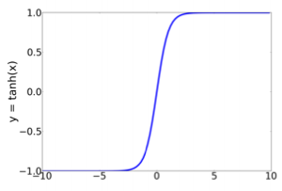
Non-linear Output Functions: Tanh
More commonly used as an activation function
In practice often better results than sigmoid

Slide 14
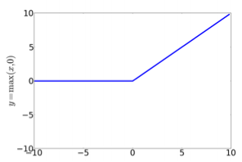
Non-linear Output Functions: ReLU
Simplest activation function
Most common activation function
Nearly linear

Slide 15
Feedforward Networks

Slide 16
Feedforward Network
Feedforward networks are also called multilayer perceptrons (or MLPs)
Multiple layers of perceptrons with nonlinear functions between layers
Can represent more complex decision boundaries
They can compute XOR

Slide 17
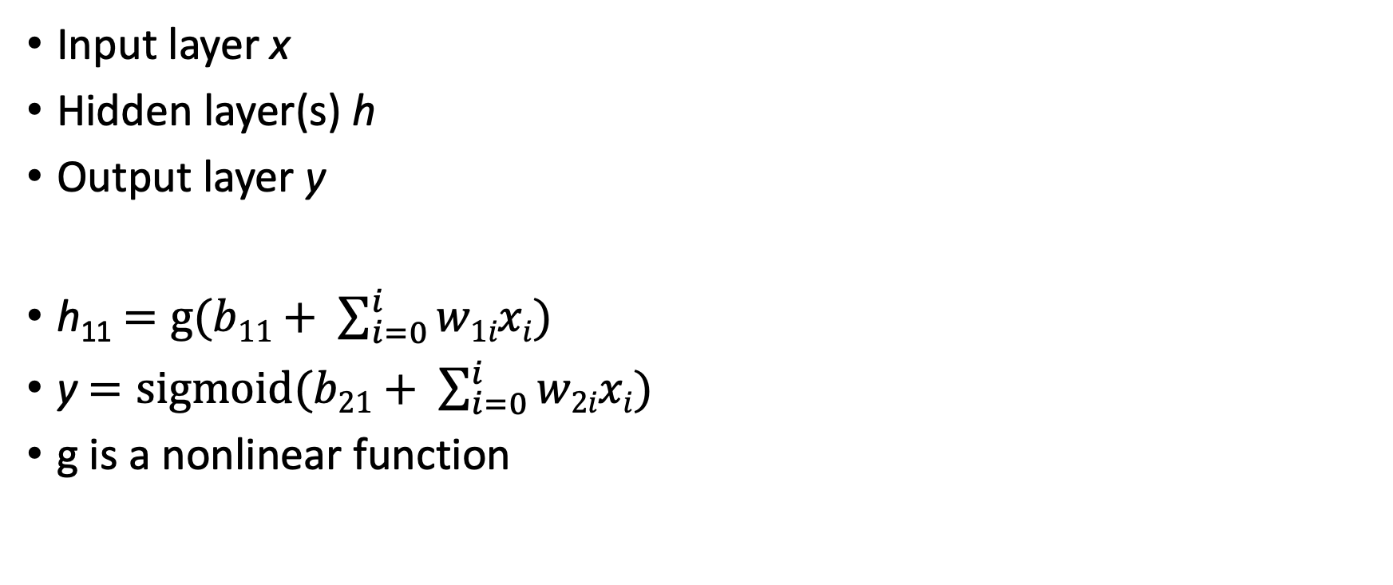
Feedforward Network
Input layer x
Hidden layer(s) h
Output layer y
h₁₁ $=g(b11+ \sum_{i=0}^{i}{w1ixi)}$
y $=sigmoid(b21+ \sum_{i=0}^{i}{w2ixi)}$
g is a nonlinear function

Slide 18
Feedforward Network: Example
Weights w_1=[2, 4, 8] <repeat formula here>
Bias b_1 = 0
Weights w_2 = [3]
Bias b_2 = 1
Inputs x=[0, 0.2, 1]
What is the output?

Slide 19
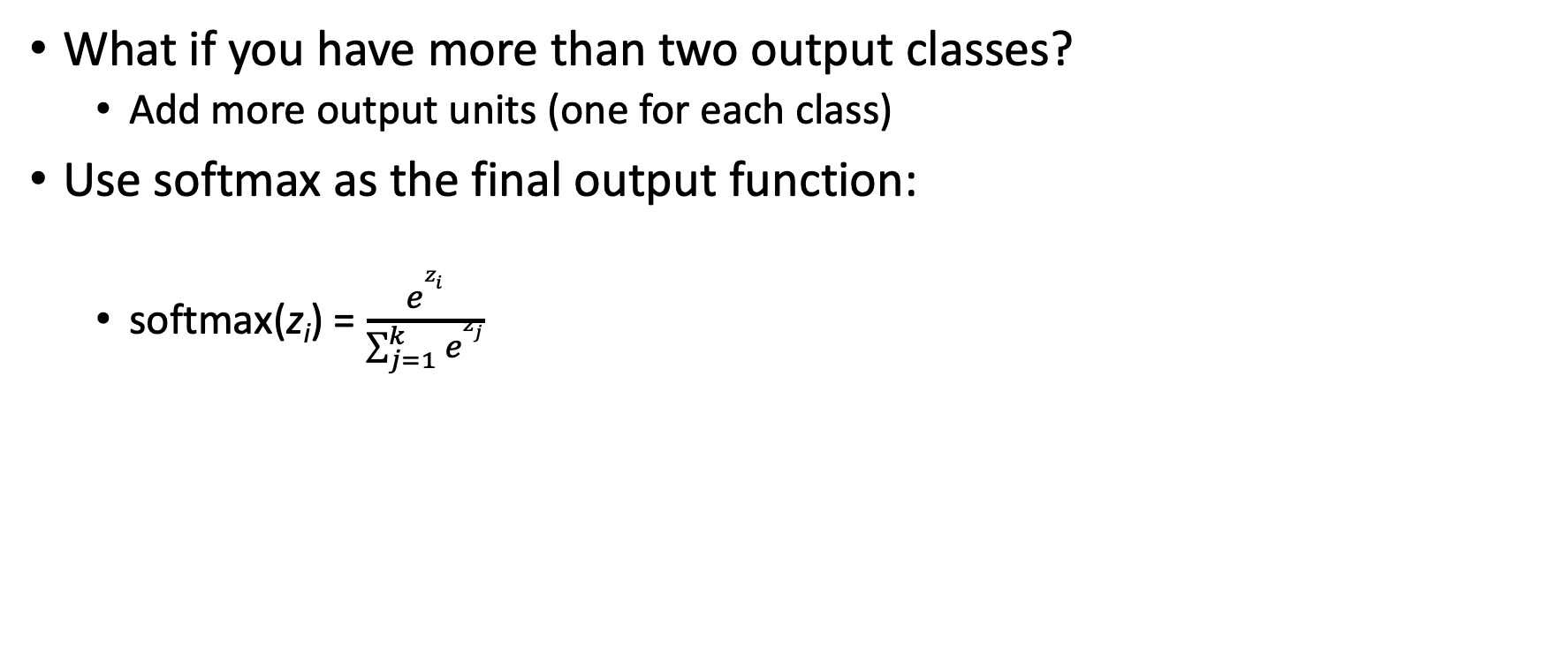
Multiple Output Classes
What if you have more than two output classes?
Add more output units (one for each class)
Use softmax as the final output function:
softmax(z_{i}) = $\frac{ez_{i}}{\sum_{j=1}^{k}{ez_{j}}}$

Slide 20
Softmax
Softmax is the normal nonlinearity in the output layer for one-of-many predictions
Softmax returns a probability distribution
Values are between 0 and 1
Values add up to 1
Example:
3 classes
z = [130, 34, 91]
softmax(z) = [1.0000e+00, 2.0305e-42, 1.1548e-17]

Slide 21
Number of Parameters
Parameters in the first layer:
4*3 + 3 = 15
Parameters in the second layer:
3*1 + 1 = 4
Total: 19
This is a tiny network!
Typical dimensions are much larger (easily 1000 for input and hidden layers)
That would make 102001 parameters

Slide 22
Training Neural Networks

Slide 23
About Weights
To learn the weights, we need some measure of how well (or badly) we are doing with a current set of weights.
We will call that measure a loss function
The lower the loss the better we are doing
We want to minimize the loss

Slide 24
Loss Functions
There are lots of ways to measure how well we’re doing on a test/validation set.
How many examples are right?
How close our answers are to the correct answers?
What does close mean?

Slide 25
Cross-entropy Loss
For a given example, we will go with the probability assigned to the right answer by the model
In the binary case, the right answer is always either 1 or 0
The model produces a number between 1 and 0 that is the starting point for the loss
p(y|x) = y’^{y}(1-y’)^{1-y}

Slide 26

Cross-entropy Loss
p(y|x)= y’^{y}(1-y’)^{1-y}
If the correct answer for an example is 1 and the system output is .7 then the probability of the correct answer is…
.7

Slide 27
Cross-entropy Loss
p(y|x)= y’^{y}(1-y’)^{1-y}
If the correct answer for an example is 0 and the system output is .8 then the probability of the correct answer is…
.2

Slide 28
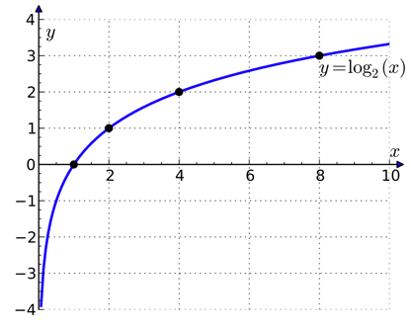
Logs
Probabilities aren’t exactly what we want. We want worse performance to have high loss and good performance to have low loss.
So we take the negative of the log of the probability assigned to the correct answer as the loss.

Slide 29
Stochastic Gradient Descent
TODO: some motivation; e.g., we want to minimize the loss

Slide 30
Stochastic Gradient Descent

Slide 31
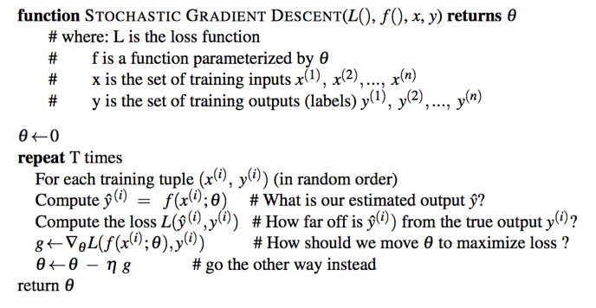
Stochastic Gradient Descent

Slide 32
Optimization
In practice, that can be slow to converge because the algorithm can either be taking steps…
…that are too small and hence take us too long to get where we are going
…or too large, which leads us to overshoot the target and wander around too much
Fortunately, you don’t have to worry about this: lots of packages exist that let you specify the loss function and parameters and you are done

Slide 33
Optimizers besides SGD
TODO

Slide 34
Batches
TODO

Slide 35
Regression
If you want to perform regression instead of classification, all you need to do is:
Remove the final sigmoid function
Change the loss function for training
Standard loss function: mean squared error (MSE)

Slide 36
Exercise: Feedforward Networks
In this exercise, we will build a neural network-based sentiment classifier
Open BYOSC_data.csv and familiarize yourself with the format
Then open module5.ipynb
There are multiple TODOs: find them and complete the code, such that it can run!
Final goal: report the accuracy your network obtains on the data

Slide 37
Convolutional Neural Networks

Slide 38

Motivation
Convolutional neural networks use filters to process the input with an increasing degree of granularity
Often used in image processing
CNNs also have applications in other areas, such as natural language processing

Slide 39
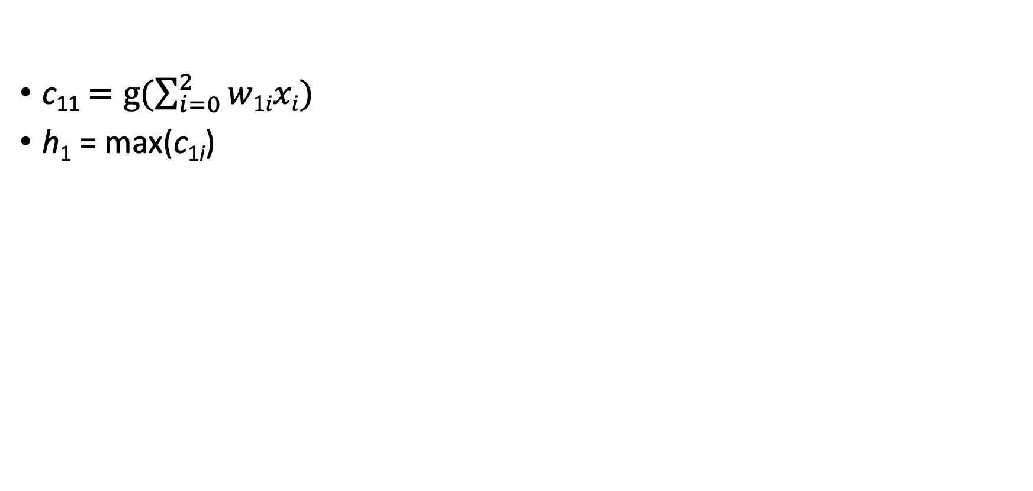
Convolutions
c₁₁ $=g(\sum_{i=0}^{2}{w1ixi})$
h₁ = max(c_{1i})
Max pooling

Slide 40
Convolutional Neural Networks
Other options instead of maximum:
Minimum
Average
Filter size is a hyperparameter:
Something you decide on with the development set

Slide 41
Convolutional Neural Networks
The output of a convolutional layer can be the input for a classifier, for example:
Logistic regression
Feed-forward network
…
Different filter sizes can be combined
Convolutional layers can be stacked on top of each other

Slide 42
What are CNNs useful for?
TODO: applications
Also maybe add a picture of a CNN from an image paper

Slide 43
Recurrent Neural Networks

Slide 44
Motivation
Recurrent neural networks can process sequential data of arbitrary length
This is different from feedforward networks
Until ~2018, they were frequently used for language data
Examples:
Machine translation
Text summarization
Question answering
…

Slide 45
Recurent Neural Network
Input layer x
Hidden layer(s) h
h_{i} = g(W_{h}h_{i-1} + W_{x}x_{i})
y = sigmoid(W_{y}h_{T})
g is a nonlinear function

Slide 46
Recurent Neural Network
Input layer x
Hidden layer(s) h
h_{i} = g(W_{h}h_{i-1} + W_{x}x_{i})
y_{i} = sigmoid(W_{y}h_{i})
g is a nonlinear function

Slide 47
Recurrent Neural Networks
Processes a sequence using the same matrix for each input
Maintains a representation of the history up to each input
Challenge:
During backpropagation, since RNNs multiply the same matrix over and over, gradients vanish or explode
Cannot capture long-term dependencies (or learn much) with uninformative gradients
History gets forgotten over time

Slide 48
Recurrent Neural Networks
The flights the airline was canceling were full.

Slide 49
Recurrent Neural Networks
Gradient Clipping: Normalize the gradient of a parameter vector when its L2 norm reaches a certain value.
Explicit memory cell with which a model can keep important long-term information.
LSTM (Hochreiter and Schmidhuber, 1997)
GRU (Cho et al., 2014)

Slide 50
LSTMs vs. GRUs
LSTMs and GRUs are based on similar ideas, but the LSTM has slightly more parameters
Performance is usually extremely similar

Slide 51
Attention and Transformers

Slide 52
Motivation for Attention
Not all parts of the input are equally important
Example:
Q: “When was Barack Obama born?”
Reference: “Barack Obama was born in 1961 in Honolulu.”
The idea of attention is to compute the importance (or weights) of each input, given a query
Attention has shown to be very useful for many NLP tasks, such as machine translation

Slide 53
Transformers
Transformers process sequences of arbitrary lengths using attention and feedforward layers
Can be used to:
Process input sequences
Generate output sequences
Image from Vaswani et al. (2017)

Slide 54
Transformers – Pros and Cons
Pros:
Training can be parallelized – training is faster than for RNNs
Performance is often slightly better than for RNNs
Cons:
Transformers have been reported to be more sensitive to small hyperparameters changes
Might be a worse model of human cognition

Slide 55
Pretrained Neural Networks Online and How to Use them

Slide 56
For Images
TODO

Slide 57
For Text
TODO

Slide 58
Challenges

Slide 59
Data
Neural networks are data hungry!
Possible mitigation strategies:
Semi-supervised learning
Transfer learning

Slide 60
Biases
Neural networks learn unwanted biases from data
You have already heard about that!
Possible mitigation strategies:
Collect data without biases
Remove biases from data
Design training such that biases aren’t learned

Slide 61
Hardware Constraints
Large neural networks need lots of memory
Some can’t easily be run on a standard GPU
Training can take very long and might occupy hardware needed for other purposes

Slide 62
Environmental Concerns
Training of large networks causes a lot of CO2 emission
Training one time is bad, but what is really problematic are experiments needed for hyperparameter tuning

Slide 63
Interpretability
Neural networks are not easily interpretable
It is not easy to understand why they take the decisions they take
Using them for applications where decisions need to be manually verified is difficult
Candidate screening
Criminal trials
…

Slide 64
Thank you!

Slide 65
Gated Recurrent Neural Networks

Slide 66
Gated Recurrent Neural Networks
Update gate: controls how much of the previous hidden state to update

Slide 67
Gated Recurrent Neural Networks
Reset gate: controls how much of the previous hidden state to keep

Slide 68
Gated Recurrent Neural Networks

Slide 69
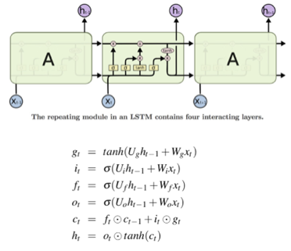
Long Short-Term Memory Networks (LSTMs)
First proposed by Hochreiter and Schmidhuber (1997).
Similar to the GRU, but some more parameters.
Performance is usually extremely similar.
Three gates:
Add gate
Forget gate
Output gate

